Slide 1
KUBERNETES
TAMMANA KARTHIK(BT18GCS075)

Slide 2
INTRODUCTION
Kubernetes is a portable, extensible, open-source platform for managing containerized workloads and services, that facilitates both declarative configuration and automation.
The name Kubernetes originates from Greek, meaning helmsman or pilot
Kubernetes services, support, and tools are widely available.
It was developed by google and later donated to CNCF(Cloud native computing Foundation)

Slide 3
Why we require Kubernetes?
Kubernetes provides an easy way to scale the application, compared to virtual machines. It keeps code operational and speeds up the delivery process.
Containers are a good way to bundle and run the applications. In a production environment, we need to manage the containers that run the applications and ensure that there is no downtime.Kubernetes does this on its own.
It takes care of scaling and failover for the application, provides deployment patterns, and more.

Slide 4
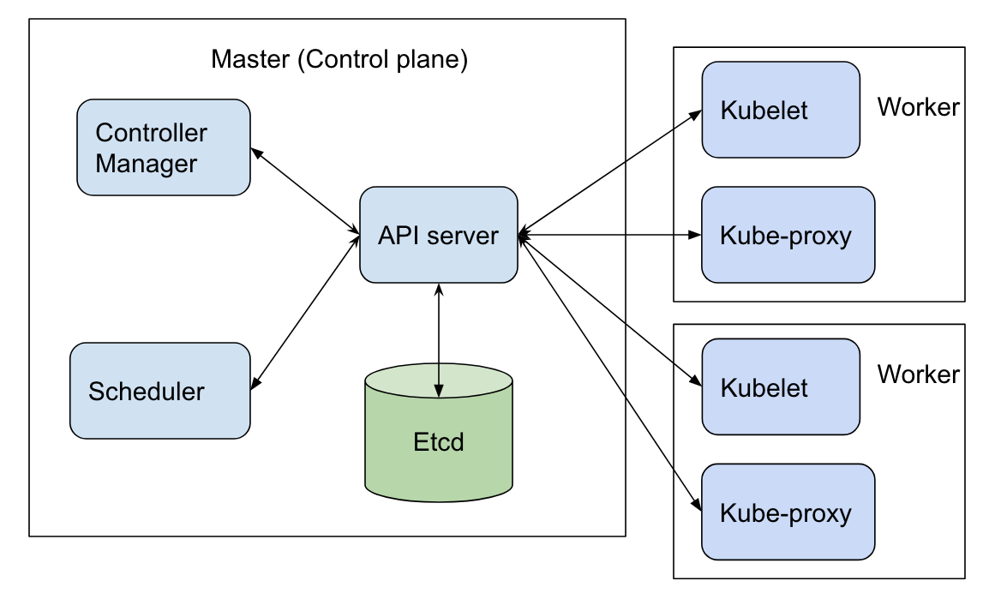
COMPONENTS OF KUBERNETES

Slide 5
Components Cont..
API SERVER: This allows applications to communicate with each other. The users,management devices and command line interfaces talk with this server to interact with the kubernetes cluster.
SCHEDULER: It Schedules PODS across multiple nodes. It gets info from the etcd and schedules pods accordingly.
ETCD : It is an Open Source and Distributed key-value db which is consistent and used for backing up of all Cluster related data. It acts as brain of the cluster.

Slide 6
Components contd..
Control-Manager: A Component that runs controllers like Node controller, Replication controller etc. It is responsible for overall health of cluster. It ensures nodes are running all the time and correct no:of pods are running as per the spec file.
Kubelet : It is an agent running on each node communicates with components on Master Node. It makes sure that containers are running inside pods.
Kube-proxy : It is a network-proxy which helps in implementing part of the kubernetes Service concept by doing load balancing.
Container-Run time: This is a software responsible for running containers.

Slide 7
Keywords in Kubernetes
Pod: A smallest unit of K8s and it is a abstraction over the container with its own Ip address.
Service: A kubernetes service is a logical abstraction for a pod which sets a static ip for the pods in a node.
Ingress : It is an API object that provides routing rules to manage external users' access to the services in a Kubernetes cluster.

Slide 8
Keywords Cont..
Secret: In kubernetes, sensitive data like passwords and keys are handled using secret. It is a kubernetes object created outside the pods. It is base64 encoded.
Config Map: In kubernetes, configurations are handled using config-map and it is also a kubernetes object created outside the pods.

Slide 9
Difference b/w K8S and Docker
A fundamental difference between Kubernetes and Docker is that Kubernetes is meant to run across a cluster while Docker runs on a single node.
Kubernetes is more extensive than Docker Swarm and is meant to coordinate clusters of nodes at scale in production in an efficient manner
Docker Swarm is more convenient to set up but doesn’t have a robust cluster, while Kubernetes is more complicated to set up but the benefit of having the assurance of a robust cluster
Docker Swarm doesn’t have a GUI; Kubernetes has a GUI in the form of a dashboard

Slide 10
THANK YOU !

